Slide 1
Weekly updates - 08/09/2021 - AI Institute
Progress made last week
- Reviewed 130 reports file, and revised relationship diagram
- Reviewed Material Master User manual documentation
- Brainstormed Shawn’s meeting notes, Questions, video
Plan for this week
- Continue to review the Zgrve and 130 reports and working to understand the header definitions
-Study Material Master User Manual documentation
- Identify important fields for Material Planning
- Prepare data dictionary to create database Improve relationship diagram

Slide 2
MRP #
Vendor Name
Vendor #
Traffic
Signal
Material
Planner
has
1..*
Supplier
(Vendor)
Model
Name
recommend
Models
Responsible
supply
1..*
Conditions
Material
Planning
Used in
1..*
1..*
triggers
has
use
Material
(Parts)
use
1..*
StckDS*
Exception
Stock Inventory
1..*
StckDS - Stock Days’ Supply currently at plant (in Days)
1st RDS*
Code #
desc.
RDS - inventory in transit from a supplier to BMW (in Days)
2nd
RDS*

Slide 3

Output
MRP #
Vendor Name
Vendor #
0 %
100 %
Risk
Meter
Material
Planner
has
1..*
Supplier
(Vendor)
recommend
Responsible
supply
Conditions
1..*
Material
Planning
has
1..*
triggers
input
use
input
Material
(Part)
use
1..*
Exception
1..*
Material Inventory
Code #
desc.
triggers

Slide 4
Weekly updates - 08/16/2021 - AI Institute
Progress made last week
- Reviewed 130 reports file, and revised relationship diagram
- Reviewed Material Master User manual documentation
- Brainstormed Shawn’s and Joshua’s meeting notes, Questions, video and revised relationship diagram
- Drafted an initial system design for feedback
Plan for this week
- Continue to review the Zgrve and 130 reports and working to understand the header definitions
- Continue Identify important fields for Material Planning
- Continue revising ER diagram
- Prepare data dictionary to create database
- Continue to improve system design

Slide 5
MRP #
Vendor Name
Vendor #
0 %
100 %
Health
Status
Material
Planner
has
1..*
Supplier
(Vendor)
recommend
Responsible
supply
use
Output
1..*
Material
Planning
has
Material
(Part)
input
Material Inventory
input
use
Code #
generate
Exception
Desc.
Criticality
Level

Slide 6
Attributes changes frequently
(Material Transactions)
Attributes do not change frequently
(Material Config./ Material Master)
DepReq - Dependent Requirement, Reqmt of Stck Qty, based on Forecast and Firmed Orders
IndReq - Order Forecast of stck
Safety
Stck
Safe
Time
IndReq
DepReq
StckDS*
(in days)
Planning Time Fence (in days)
MRP
Type
Available
Qty
has
MRP
Area
Material (Stck)
Inventory
Material*
(Part)
ShipNt
Available Inventory at warehouse
Plant
ShipNt - Ship Note, Num of stck in transit
Available Inventory at Plant
Material
Type
Material ID, Desc.
Lot size
SchAgr
generate
Planning Calendar
The quantity of stck we are expecting to be picked up from Supplier. It will be delivered on a date.
Exception

Slide 7
Examples: Exceptions msg from Inventory
ShipNt - an exception message is generated when a shipment is not delivered on time.
SchAgr - An exception message is generated when a schedule Qty is not high enough
AvailableQty - an exception message is generated when a stock Qty is negative
SafetyStck - an exception message is generated when a high value of safety stock causing the available qty in negative

Slide 8
Shipment status...
Shipment Status | Description
Warehouse | Ordered parts currently are in Warehouse
Yard | Ordered parts currently are in Yard
On Road (in transit) | Supplier has delivered the parts. and now the ordered parts currently in transit.
Line Site | Ordered parts are currently at the production site
Partial Shipment | Parts has been delivered, but partially.
?
?

Slide 9
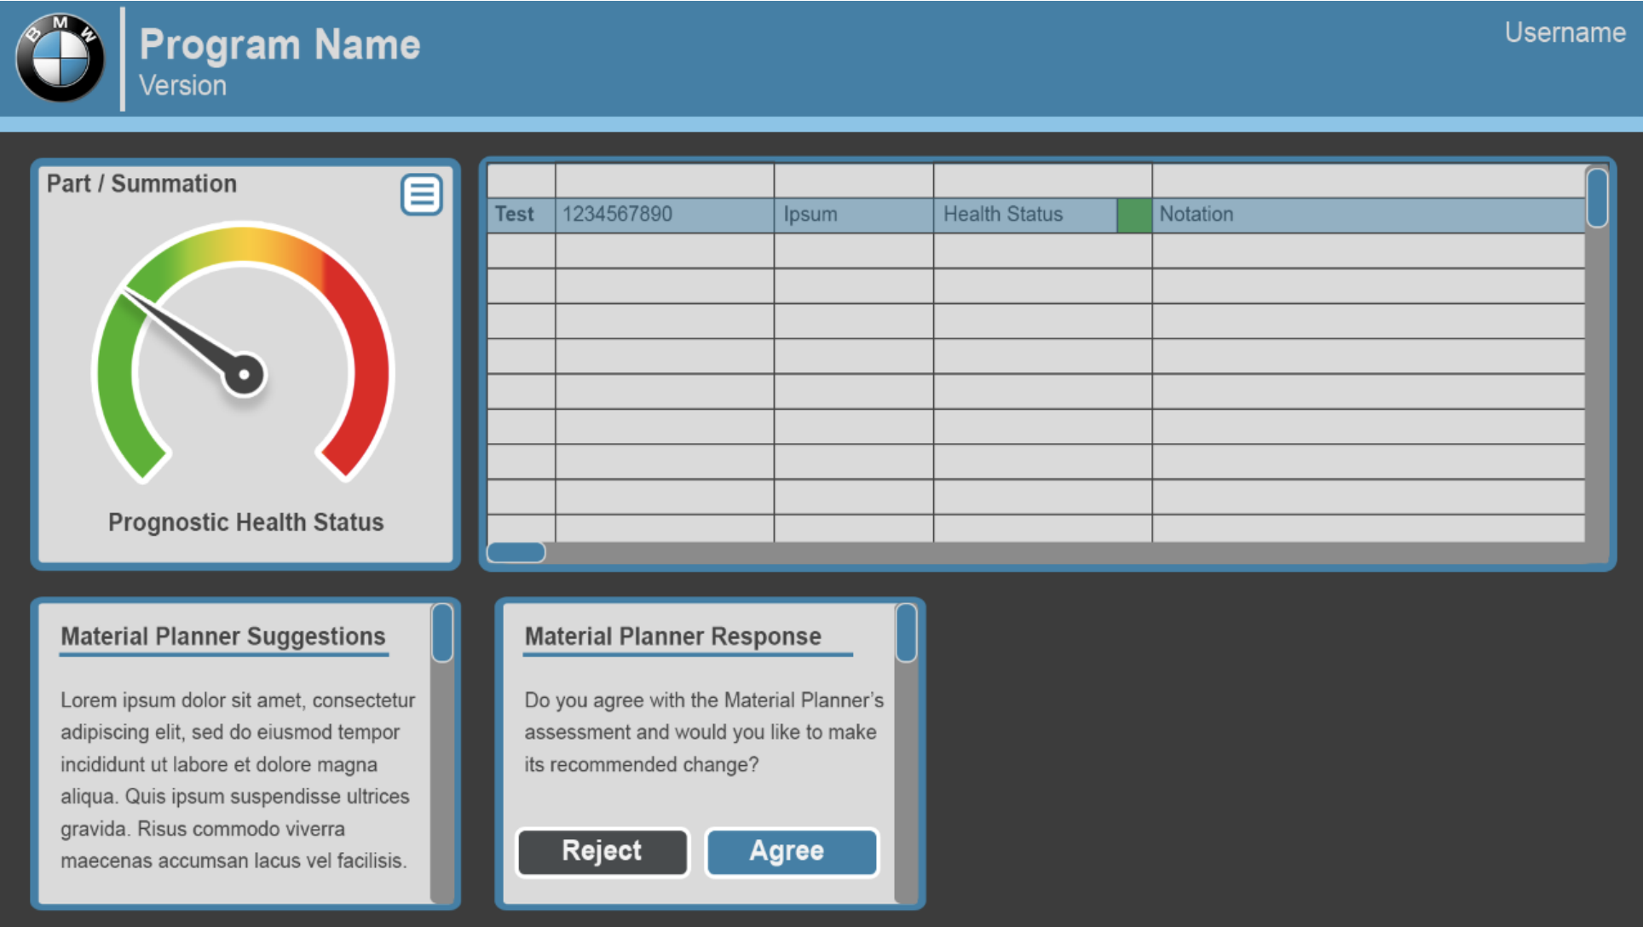

Slide 10
Health Status recommendation (Risk Meter)
0 %
100 %
Health Status | Rules
100 % | StockDS (Stock Days of supply) is below than certain threshold
https://docs.google.com/spreadsheets/d/1Jr4OLDbhrurwBfPHegpD_yg4KM-7z_Xs8QI0ucu7G10/edit?usp=sharing

Slide 11
Common exception

Slide 12
Questions
How the material planner will be deployed (or used, integrated) into existing system at BMW?
How the material planned data from existing SAP system will be imported into the material planner system?
Is there any formula to calculate stckDS (Stock Days of supply) ?

Slide 13
Health Status
Signals | Description
Red | Require an immediate attention.
Yellow | Situations to be monitored but not critical
Green | There is no exception message and no issues.

Slide 14
Output
MRP #
Vendor Name
Vendor #
Health
Status (in %)
Material
Planner
has
1..*
Supplier
(Vendor)
Model
Name
recommend
Models
Responsible
supply
1..*
Conditions
Material
Planning
Used in
1..*
1..*
triggers
input
has
use
Material
(Part)
use
1..*
input
Exception
Material Inventory
1..*
Code #
desc.

